Slide 1
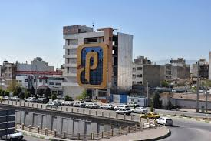
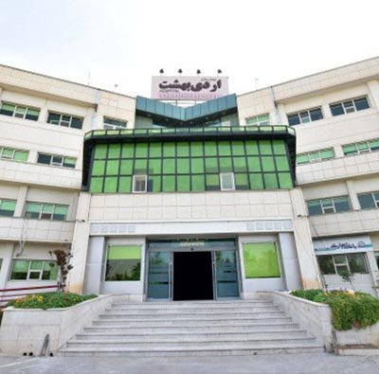
ADVANCED SKILLS TRAINING DIPLOMA IN BREAST CANCER SURGERY (3 MONTHS)
ADVANCED SKILLS TRAINING DIPLOMA IN BREAST CANCER SURGERY
Ordibehesht Hospital, Pardis Cancer Institute, Shiraz, Iran
Programme Director: Majid Akrami MD
Duration: 3 months
COURSE DATES, From: 01/11/2024 To: 01/02/2025
REGISTRATION FEE: 6000 $
Application deadline: 01/10/2024
Notification of acceptance: 10/10/2024
PAYMENT PLAN : PAYMENT IN PERSON AT BEGINNING THE COURSE

Slide 2
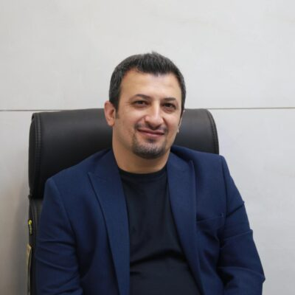
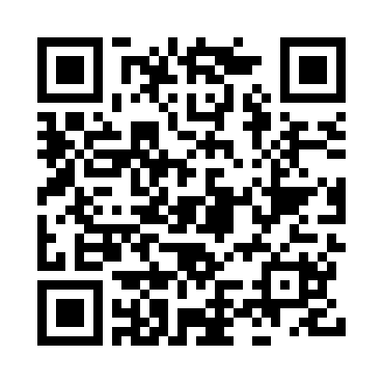
Program Director
Majid Akrami MD
Surgical Oncologist
Associate Professor of Surgery
Shiraz University of Medical Sciences
Shiraz, Iran.
E-mail: akramimd2@gmail.com
Curriculum vitae (cv)

Slide 3
DESCRIPTION
During this period
the fellow will be totally integrated in the Oncologic Surgery Department, joining in all the clinical activities, outpatients, rounds, tumor boards and operating rooms, …
The places offered are:
Ordibehesht hospital (operating rooms, ward)
Pardis Cancer Institute (outpatient, MDT)
The duration is 3 months.

Slide 4
You will obtain specialization in breast surgery fields
Different types of partial and total breast reconstruction will be developed including autologous reconstruction (pedicled flaps and perforator flaps), implant based reconstruction, risk reducing mastectomy with immediate implant reconstruction and breast cancer oncoplastic approaches.
The Surgical techniques of breast reduction and mastopexy, implant breast augmentation procedures and revisional breast surgery will be performed.
We also encourage the fellow to join at the research activities of the Department.

Slide 5
General Surgeons or last year training residents in General Surgery. Plastic surgeons or plastic surgery fellows. Oncologic surgeons or oncologic surgery fellows.
ELIGIBILITY
SELECTION CRITERIA
Currículum Vitae
Motivation letter or personal statement
FEE
3 months: 6000 dollars

Slide 6
RESPONSIBILITIES
Clinics: 2 days of clinics per week, visiting new cases of breast cancer and follow up of known cases of breast cancer.
Ward: Attend to ward round together with the breast team 1 day per week.
Surgery: Fellowships assist in breast surgeries 2-3 days per week.
Teaching: Fellowships are participated in weekly MDT conferences, tumor boards and journal club. They are expected to join at the research activities of the department.

Slide 7
APPLICATION
To apply for the Clinical Program Advanced Skills Training Diploma in Breast Cancer Surgery, please submit the completed Application Form via email address akramimd2@gmail.com
Once received and evaluated your information, you will receive the notification of acceptance or non acceptance and more information about details.
Application deadline: 01/10/2024
Notification of acceptance: till 10/10/2024

Slide 8
Application Form
Last name:
First name:
Position:
Organization:
City / Town:
Country:
E-mail:
Telephone number:
Passport number:
considerations:

